Slide 1
Generating Java Code
Dr Steffen Zschaler
Notes:
<CTRL-SHIFT-HOME><CTRL-SHIFT-2>
Welcome.
Finally, we need to write a program that generates code from our model.

Slide 2
Tasks
We have two sub-tasks:
Generating a Java class for each UML class
Generating behaviour (method implementations) from state machine
Notes:
We have two parts to our model and, consequently, we have two parts to our generation task:
We need to generate a Java class for each UML class and
We need to generate some method implementations for our class from the state machine.
Let’s start by <ANIMATE> looking at how to generate a Java class.

Slide 3
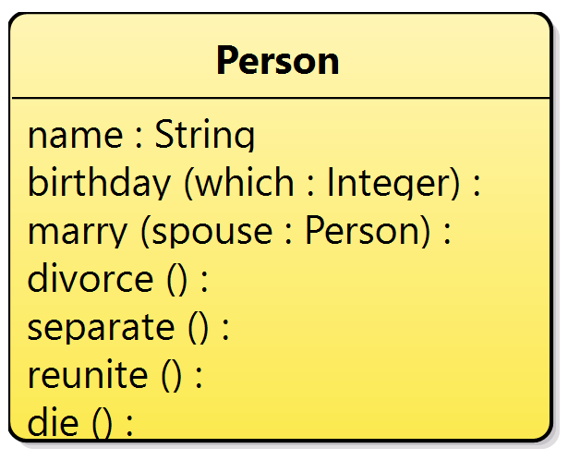
Generating a Java class for each UML class
package person;
public class Person {
private String name;
public Person() { }
public void birthday (Integer which) { }
public void marry (Person spouse) { }
public void divorce () { }
public void separate () { }
public void reunite () { }
public void die () { }
}
Notes:
Here’s what we want to achieve: For the class on the left, we want to generate the Java code on the right.
Note how the generated code contains the attribute definition and stub definitions for each method as well as a constructor.

Slide 4
Basic algorithm
operation generateJavaClassCode (p : Package)
for each Class c in p.getClassifiers do
let s ← generateJavaCode(c)
create file c.name + “.java” and write s into it
end for
operation generateJavaCode (c : Class)
let s be an empty string
add “public class “ + c.name + “ {“ to s
for each Attribute a in c.getAttributes do
add “private “ + a.type.name + “ “ + a.name + “;” to s
end for
add constructor declaration to s
for each Method m in c.getMethods do
add “public “ + m.type.name + “ “ + m.name
+ “(“ + generateParameterList(m.parameters) + “) { }”
to s
end for
add “}” to s
return s
Notes:
A program is just a bit of text – or a String in Java speak.
So our basic algorithm is this: we take a package and for each class in it, we generate some Java code as a String and then save this in a file of the right name.
<ANIMATE>
Generating the actual Java code means constructing the corresponding String bit by bit, using the model information where appropriate as shown here.

Slide 5
Introduction to Xtend
We will use the Xtend language to build our code generator
Essentially Java, with some added features
Multi-line string templates
Write string literals between ''' and '''
Strings can then go on over multiple lines
Can insert expressions using « and » as delimiters
Replaced by result of evaluating the expression
Opportunity to query the model and insert data directly from the model
Functional-programming short-hands for looping over collections
E.g., map to translate every element in a collection into a different object and create a new collection of those objects
def generateJavaCode (Class c) '''
public class « c.name » {
…
}
'''
Inserted expression
Multi-line string template
def generateMethods (Class c) {
c.methods.map[m |
'''public void « m.name » '''
].join(“\n”)
}
Join all elements of the collection into
one string, using the given separator
Map: translate one collection
into another element by element
Notes:
We will use a variant of the Java language called Xtend to implement our code generator.
This language adds to Java the ability to <ANIMATE> easily construct strings using so-called template expressions.
Here, <ANIMATE> is an example template expression for our generateJavaCode method. Note how <ANIMATE> the whole template is enclosed in triple quotes.
All the text in the template expression will directly become part of the String we are generating, except for the bits between the strange angular brackets <ANIMATE>.
These are expressions that will be evaluated and the result will be inserted into the String we are generating.
For example, here we are inserting the name of the class for which we are generating code.
In addition, <ANIMATE> Xtend gives us a really nice and compact notation for querying data from the model objects.
<ANIMATE> Here is an example of this.
This <ANIMATE> expression takes every element in the collection of methods and translates it into a piece of text using the template expression inside.
<ANIMATE> These strings are then all glued together into one long string with a new-line character between each.

Slide 6
Demo: Generating a simple class skeleton
Notes:
Let’s look at this in actual code.
<PAUSE FOR INSERTION OF A BRIEF DEMO VIDEO>

Slide 7
Tasks
We have two sub-tasks:
Generating a Java class for each UML class
Generating behaviour (method implementations) from state machine
Notes:
Let’s next look at how to generate the behaviour implementations from the state machine.

Slide 8
Generating code from a state machine
We need to generate something more than just a class skeleton
Looking to implement behaviour described by state machine
Only allow methods to be called if they can be called in current state
State should change in response to method calls, as defined by state machine
How to implement this?
Could have an attribute in class holding current state (e.g., as an integer value)
And a big if-sequence in every method checking which state we are in and what the appropriate response should be
Notes:
We need to generate more than just a skeleton of empty methods.
Luckily, the state machine diagram describes what the behaviour should be.
In particular, we should only be able to invoke a method if the current state of the object knows how the respond to it. Otherwise, we should throw an exception to indicate that this method call shouldn’t have happened.
As we call the methods, the object’s state should change in accordance with the state machine model.
How would we implement this?
A first idea is to add an attribute to our generated class that stores an integer indicating the current state. We then add a big if statement to each method to check the current state and respond accordingly.
Let’s take a look at what that would look like.

Slide 9
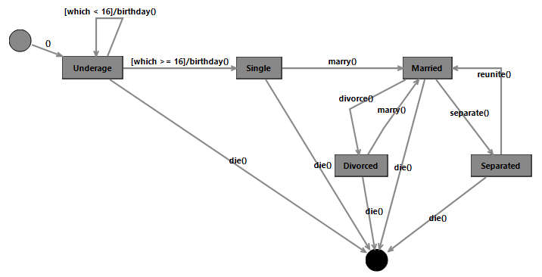
Generating a Java class for each UML class
package person;
public class Person {
private String name;
private int state = 0;
public Person() { }
public void birthday
(Integer which) {
switch (state) {
case 0: // Underage
if (which >= 16) {
state = 2;
} else if (which < 16) {
state = 0;
} else {
throw new IllegalStateException();
}
break;
case 1: // Single
throw new IllegalStateException();
case 2: // Married
// …
}
}
public void marry
(Person spouse) { … }
public void divorce () { … }
public void separate () { … }
public void reunite () { … }
public void die () { … }
}
Very complicated code – can we do better?
Notes:
<CTRL-SHIFT-4>
Here’s an excerpt of the code we would end up generating from our example class and state machine.
<BEAT>
Looks really complicated, right?
<ANIMATE>
I think this is too complicated. Let’s see if we can do better.

Slide 10
State Pattern – Problem
The behaviour of an object needs to change depending on the state of the object
For example, based on what’s happened before
You want to avoid long and unwieldy if-then-elsif chains in your code as these are really difficult to maintain
For example
Algorithm for automated vacuum cleaner has a number of states:
Charging battery as long as it’s not back to full
Moving through the room and vacuum
Return to home base when battery level is below a certain level
All behaviour captured in a central control loop function, which is executed repeatedly
Notes:
Design patterns – specifically, the State pattern – to the rescue.
This design pattern specifically addresses the situation where we need to implement a sort of state machine in our program without long and unwieldy if-statements.

Slide 11
State Pattern – Solution
Context
do()
1
state
AbstractState
do(Context ctx)
…
state.do(this)
…
ConcreteState1
do(Context ctx)
ConcreteState2
do(Context ctx)
…
ctx.setState(new ConcreteState1());
…
Special case of Strategy
Context delegates all behaviour to state
States switch to the next state whenever needed
Context object may contain data shared across states
Notes:
Here is what the pattern looks like.
In addition to the context object (the Person in our example), we create a hierarchy of state classes, one for each state in the state machine. The context object keeps track of its current state by holding a state object. Any method call to the context object is forwarded to its state object, with the context object passed in as a parameter.
If the state needs to change, then we simply ask the context object to exchange its state object.

Slide 12
Generating a Java class for each UML class
State
birthday(which: Integer,
_this: Person)
marry(spouse: Person,
_this: Person)
…
Person
birthday(which: Integer)
marry(spouse: Person)
…
1
state
Underage
birthday(which: Integer,
_this: Person)
die(_this: Person)
Single
marry(spouse: Person,
_this: Person)
die(_this: Person)
Notes:
Here is what this could look like for our example.
We have our Person object, but in addition we generate a set of state classes from the state machine and set things up so that the right methods are implemented for each state.

Slide 13
Generating a Java class for each UML class
public class Person {
private String name;
private State currentState
= new UnderageState();
public void setState
(State newState) {
currentState = newState;
}
public Person() { }
public void birthday
(Integer which) {
currentState.birthday
(which, this);
}
public void marry
(Person spouse) {
currentState.marry
(spouse, this);
}
…
public String toString() {
return "I am a person. " +
currentState;
}
}
public abstract class State {
public void birthday (Integer which, Person _this) {
throw new IllegalStateException
("Cannot invoke birthday() in this state.");
}
public void marry (Person spouse, Person _this) {
throw new IllegalStateException
("Cannot invoke marry() in this state.");
}
public void divorce (Person _this) {
throw new IllegalStateException
("Cannot invoke divorce() in this state.");
}
…
}
public class UnderageState extends State {
public void birthday (Integer which, Person _this) {
if (which < 16) {
_this.setState(new UnderageState());
}
if (which >= 16) {
_this.setState(new SingleState());
}
}
public void die (Person _this) {
_this.setState(null);
}
public String toString() {
return "I am underage.";
}
}
Notes:
The code of our Person class becomes really simple.
<ANIMATE>
Our abstract state class implements all methods by throwing an exception and
<ANIMATE> specific state implementations only override the methods that are available in that state.

Slide 14
Demo: Generating state-machine behaviour
Notes:
<CTRL-SHIFT-2>
Let’s look at this in code.
<INSERT CODE DEMO VIDEO>
---
This concludes our excursion into automatically generating code from a UML model.
On KEATS, you will find some videos exploring other ways in which models can be used to simplify the development process.
<CTRL-SHIFT-END>

